Slide 1

UNIVERSITY INSTITUTE OF COMPUTING
DEPARTMENT OF MASTER OF COMPUTER APPLICATION
UID: 21MCA2840
Name: Hariom Choudhary
Topic of Presentation: Face Recognition
DISCOVER . LEARN . EMPOWER

Slide 2
Table of Contents
Introduction
Application
Working
Output – Embedding
Output – Recognition
Output – Code
Conclusion
Reference

Slide 3
Introduction – Face Recognition
Face recognition is a technology capable of identifying or verifying a subject through an image, video or any audiovisual element of his face. Generally, this identification is used to access an application, system or service.
It is a method of biometric identification that uses that body measures, in this case face and head, to verify the identity of a person through its facial biometric pattern and data. The technology collects a set of unique biometric data of each person associated with their face and facial expression to identify, verify and/or authenticate a person.

Slide 4
Application of Face Recognition
Security companies are using facial recognition to secure their premises.
Immigration checkpoints use facial recognition to enforce smarter border control.
Ride-sharing companies can use facial recognition to ensure the right passengers are picked up by the right drivers.
IoT benefits from facial recognition by allowing enhanced security measures and automatic access control at home.
Law Enforcement can use facial recognition technologies as one part of AI-driven surveillance systems.
Retailers can use facial recognition to customize offline offerings and to theoretically map online purchasing habits with their online ones.

Slide 5
How does facial recognition work?
Step 1: Face detection
The camera detects and locates the image of a face, either alone or in a crowd. The image may show the person looking straight ahead or in profile.
Step 2: Face analysis
Next, an image of the face is captured and analyzed. Most facial recognition technology relies on 2D rather than 3D images because it can more conveniently match a 2D image with public photos or those in a database. The software reads the geometry of your face. Key factors include the distance between your eyes, the depth of your eye sockets, the distance from forehead to chin, the shape of your cheekbones, and the contour of the lips, ears, and chin. The aim is to identify the facial landmarks that are key to distinguishing your face.

Slide 6
Step 3: Converting the image to data
The face capture process transforms analog information (a face) into a set of digital information (data) based on the person's facial features. Your face's analysis is essentially turned into a mathematical formula. The numerical code is called a faceprint. In the same way that thumbprints are unique, each person has their own faceprint.
Step 4: Finding a match
Your faceprint is then compared against a database of other known faces. If your faceprint matches an image in a facial recognition database, then a determination is made.
“Of all the biometric measurements, facial recognition is considered the most natural. Intuitively, this makes sense, since we typically recognize ourselves and others by looking at faces, rather than thumbprints and irises. It is estimated that over half of the world's population is touched by facial recognition technology regularly.”

Slide 7

OUTPUT – (embedding.py)

Slide 8


Slide 9

OUTPUT – (recognition.py)

Slide 10


Slide 11
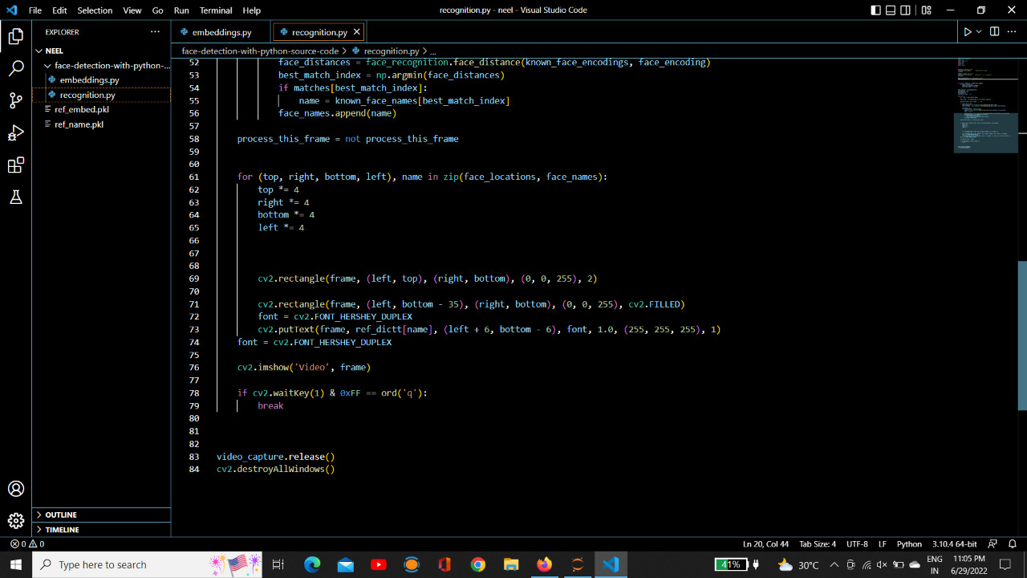

Slide 12
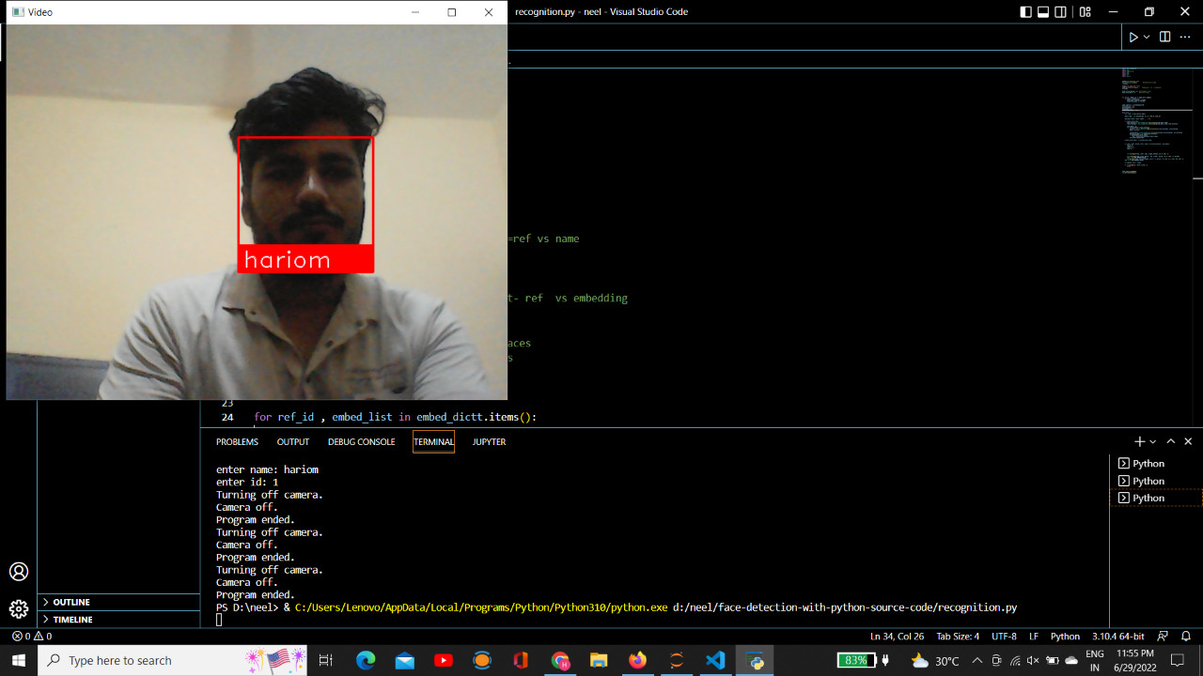
OUTPUT - Code

Slide 13
Conclusion
Face recognition is an emerging technology that can provide many benefits. Face recognition can save resources and time, and even generate new income streams, for companies that implement it right.
What lies ahead for this technology?
It’s difficult to be certain. Some experts predict that our faces will replace IDs, passports and credit card pin numbers. Given the fact how convenient and cost-effective this technology is, this prediction is not far-fetched.
If this prediction becomes a reality, any company that implemented the technology today might gain a competitive advantage in the future.

Slide 14
References
https://www.electronicid.eu/en/blog/post/face-recognition/en
https://www.kaspersky.com/resource-center/definitions/what-is-facial-recognition
https://indatalabs.com/blog/face-recognition-technology-industries#:~:text=Conclusion,companies%20that%20implement%20it%20right.

Slide 15
THANK YOU

